Slide 1
Interactive Sketch-based Method for Generating Realistic Cloth Graphics from 3D Model
Tokyo Institute of Technology, School of Computing
Saito Laboratory
18M38311
Yufei Zheng
Notes:
For all the listeners good afternoon, I am Yufei Zheng from Saito Laboratory. This is my title of my presentation today.

Slide 2
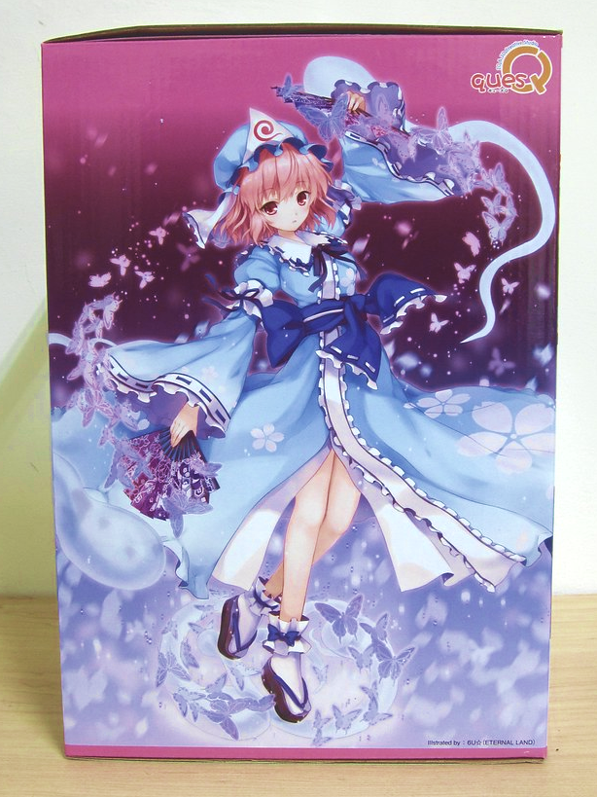
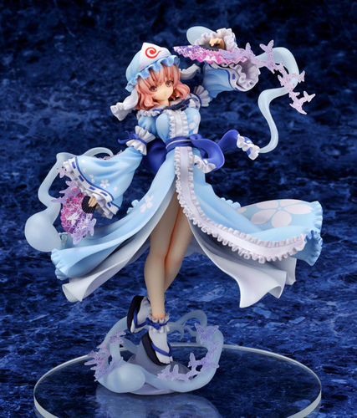
Research Background
Generating realistic cloth images
Unreal light and shade
Realistic texture and shade
Use lines and color blocks instead of real wrinkles
Realistic variable folds shapes
Folds shape of the real physical sense
Unnatural folds shapes
https://home.gamer.com.tw/creationDetail.php?sn=1886892
Amazon.co.jp 東方プロジェクト “幽冥楼閣の亡霊少女” 西行寺幽々子 完成品フィギュア
Original set image
Animation character’s figure
Traditional methods to add the details of folds on the cloth model:
Hard to learn and use, difficult to get a correct result, time consuming.
Notes:
There are several different between full 2D cloth images and realistic cloth images, especially the appearance of folds.
2D cloth images have unreal light and shade, usually use lines and color blocks instead of real wrinkles and the shape of them sometimes also unnatural. With realistic texture and shade, the realistic cloth images have variable folds shapes with real physical sense.
To make a realistic image like on the right rather than the 2D cloth image on the left, the traditional methods to add the details of folds on the cloth model is hard to learn and use, difficult to get a correct result, and very time consuming.

Slide 3
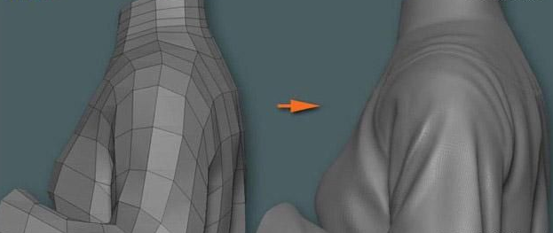
Research Background
Hard to learn and use
Create a basic shape, then modify each plane one by one
Generating realistic image by traditional modeling software
Need enough relevant professional knowledge
Interaction of the ﬁbrous tissue
Difficult to get a correct result
Force between cloth and body
Physical simulation
Gravity
Unnatural Character’s action
http://www.zf3d.com/news.asp?Id=15487
Notes:
The traditional modeling method need to create a basic shape and then modify each plane one by one. It needs not only basic skills to use these software, but also knowledge of the quality of cloth and sewing patterns.
When using physical simulations to generate the folds, it is difficult to get a correct result with too many issues that need to be considered, like interaction of the fibrous, force between cloth and body, gravity, unnatural character’s action and so on.

Slide 4
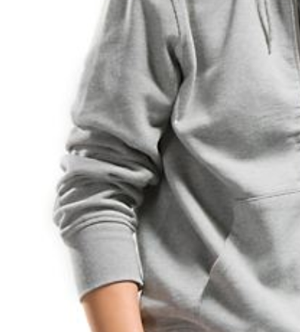
Research Propose and Final Goal
Final goal: Design and implement a method for generating realistic cloth images by sketching on the cloth model.
http://style.moonbasa.com/chaoliuqushi/1181.html
Advantage: Sketching makes the process concise. Do not need to consider the correct depth and height of folds.
Difficulty: Hard to generating the image of overlapping folds by sketching, and physical simulations without the correct fold height are difficult.
1 Input a cloth model and modify it with an initial statement
2 Sketching on the cloth model
3 Get the result
http://www.zf3d.com/news.asp?Id=15487
Notes:
Depend on these problems, my research propose and final goal is to design and implement a method for generating realistic cloth images by sketching on the cloth model. Sketching makes the process concise. As I only need to obtain realistic 2D pictures, it doesn’t need to consider the depth and height of folds.
After input a cloth model and modifyng it with an initial statement is sketching on the model, like the red curves on the left, the user can get the result of the realistic folded surface image.

Slide 5
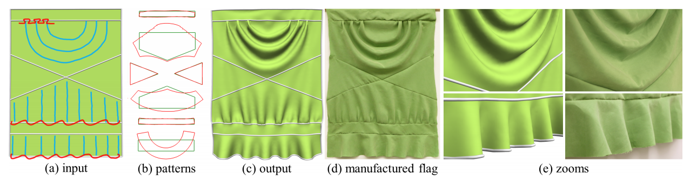
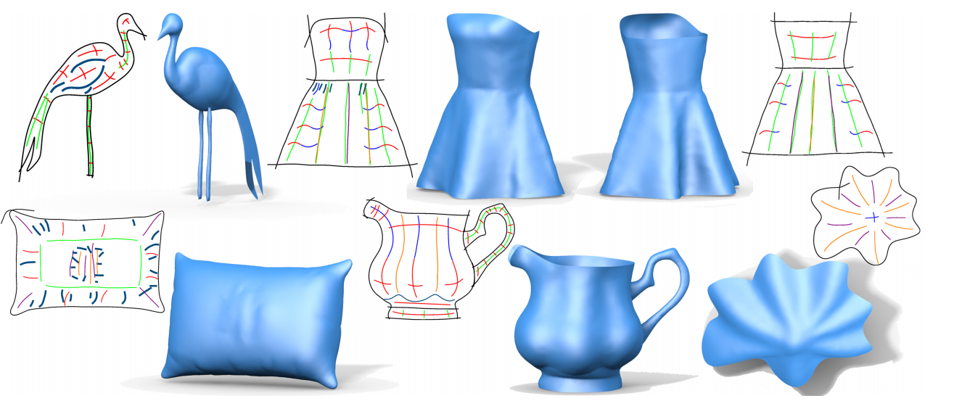
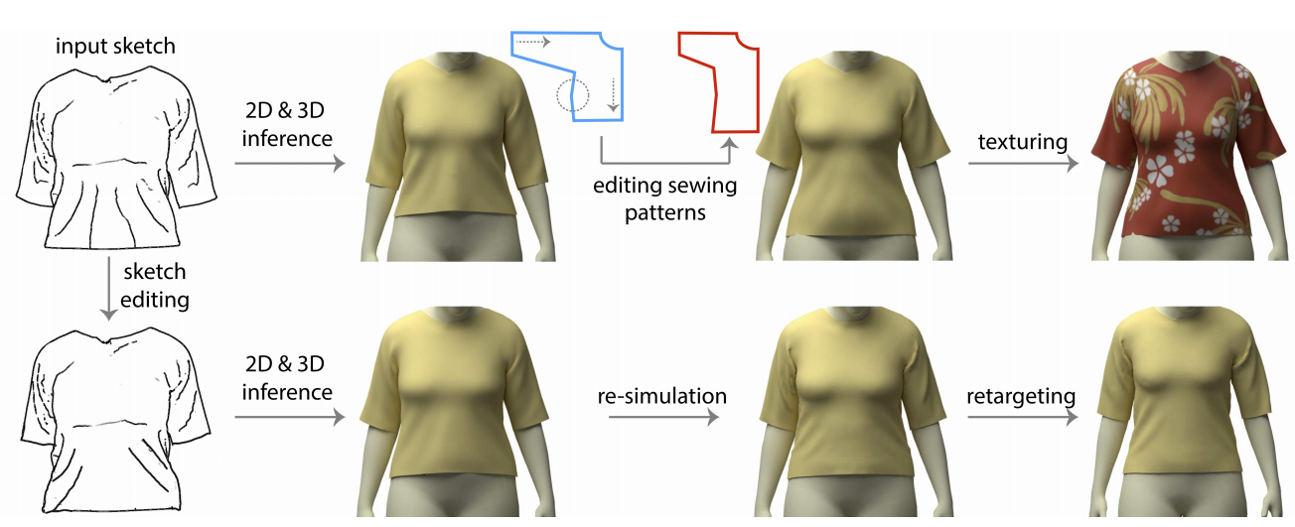
Related Works
Foldsketch: Sketch directly on the model then get the result.
Limited to the areas that can be drawn and the folds’ shapes.
Minchen Li, Alla Sheffer, Eitan Grinspun, and Nicholas Vining. Foldsketch: Enriching garments with physically reproducible folds. ACM Transaction on Graphics, 37(4), 2018.
Changjian Li, Hao Pan, Yang Liu, Xin Tong, Alla Sheffer, and Wenping Wang. Bendsketch: Modeling freeform surfaces through 2d sketching. ACMTrans. Graph., 36(4):125:1–125:14, July 2017.
Tuanfeng Y. Wang, Duygu Ceylan, Jovan Popovi´ c, and Niloy J. Mitra. Learning a shared shape space for multimodal garment design. In SIGGRAPH Asia 2018 Technical Papers, SIGGRAPH Asia ’18, pages 203:1–203:13, New York, NY, USA, 2018. ACM.
Bendsketch: Get the whole model directly by sketching.
Based on machine learning.
Enough knowledge of pattern structure and drawing is required.
Only can generate the model of cloth that the style is already existing in the database.
Notes:
Now I will introduce some related works. Foldsketch is a sketch-based method by Li with limits to the areas that can be drawn and the folds’ shapes.
Bendsketch allows the user to get the whole model directly by sketching but enough knowledge of pattern and drawing is required.
The next method is based on machine learning. It only can generate the model of cloth that the style is already existing in the database.
But all of these sketch-based methods is focus on making 3D models but not realistic images.

Slide 6
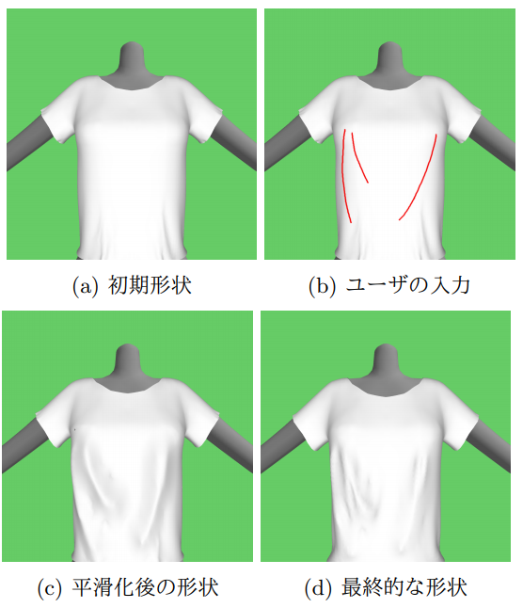
Related Works
Input models
Preprocessing
Modification of the initial state
Sketching on the model
Mesh Reconstruction
Smoothing
Modifying and get the result
Modification of the final state
More attention to the shape of the folds
More freedom where the user can sketch
Hatsu Shi, Suguru Saito,``An interactive method for adding wrinkles on cloth models to generate a convincing cloth CG'',proceedings of the 81st National Convention of IPSJ, 2ZC-03, 2 pages, IPSJ, 2019.
More freedom in the shape of folds that can be generated
Notes:
Shi’s work, another sketch-based method, is focusing on making realistic cloth images. In the preprocessing, the user can generate the modification result of the initial state of the cloth model.
After sketching on the model, the method will have a mesh reconstruction and smoothing.
Doing some final state modifying, then the user can get a realistic cloth image.

Slide 7
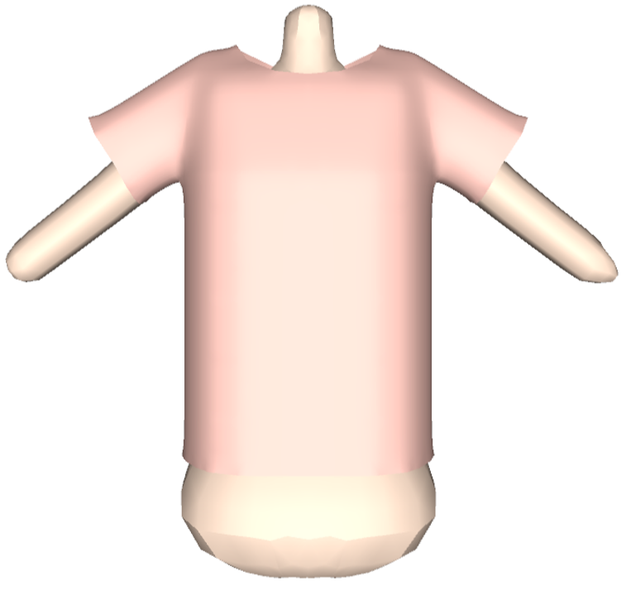
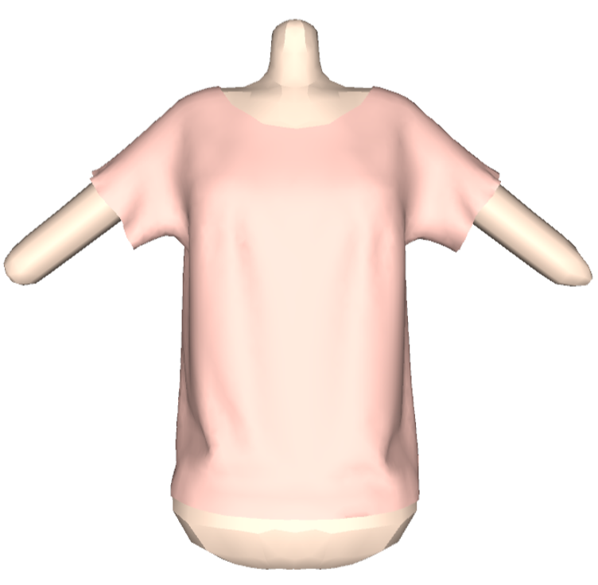
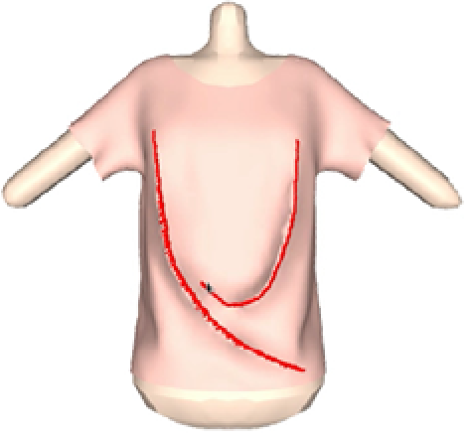
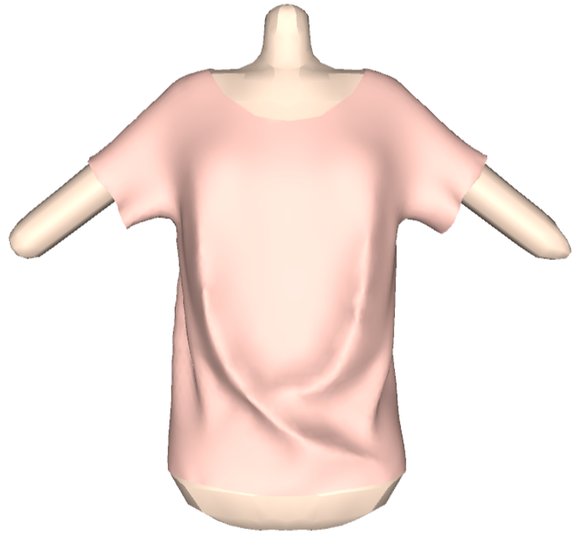
Processing Method
Improvement and innovation based on Shi’s method
Input models
Preprocessing
Modification of the initial state
1: Initial input
2: Preprocessing
Sketching on the model
Mesh Reconstruction
Smoothing
Modifying and get the result
Modification of the final state
More attention to the shape of the folds
3: Sketching on the model
More freedom where the user can sketch
4: Final result
More freedom in the shape of folds that can be generated
Notes:
Compared with other related methods, this sketch-based method focuses on producing a realistic image of folds, so it pays less attention to the height of the folds and more to the shape of the folds, has more freedom where the user can sketch and more freedom in the shape of folds that can be generated. So I select this method as a basic work.
Now I will introduce my idea of the experimental process, which is an improvement and innovation based on Shi’s method.

Slide 8
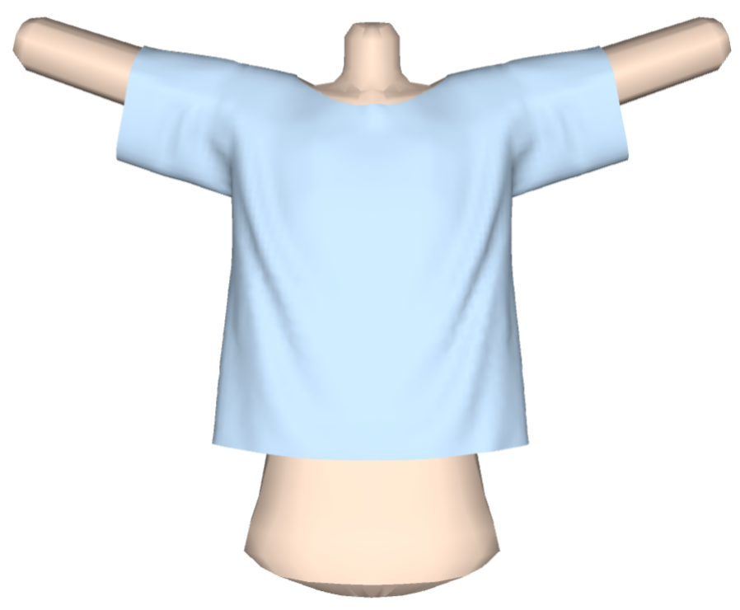
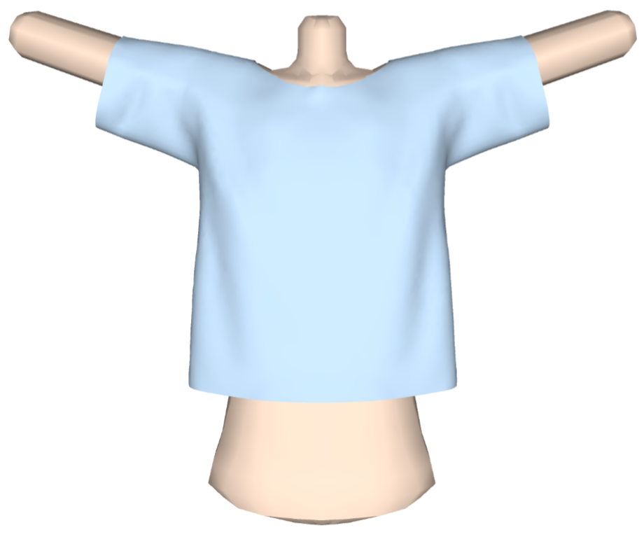
Processing Method
Improvement and innovation based on Shi’s method
Input models
Preprocessing
Not allow the user to change the parameter.
Shi’s simulation result without optimization
★ Current work
Remeshing and smoothing, time interval change in physical simulation
★ Future work
Physical simulation breaks down when the mesh is complex: more stable simulation processing
More customized initial physical states: winds, different direction gravity, rotation
Current simulation result after remeshing and smoothing
Notes:
In the preprocessing step, Shi doesn’t allow the user to change the parameter.
But in my work, I introduce remeshing and smoothing method, and the user can change time interval in physical simulation
This process breaks down when the mesh is complex so in the future I need to make it more stable.
Now the simulation is only with gravity, I’d like to introduce more customized initial physical states like winds, different direction gravity and rotation.

Slide 9
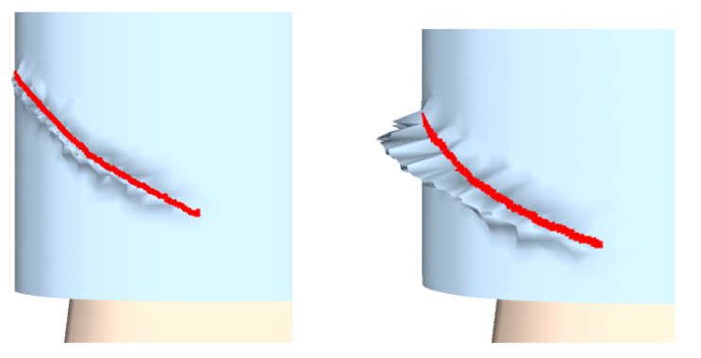
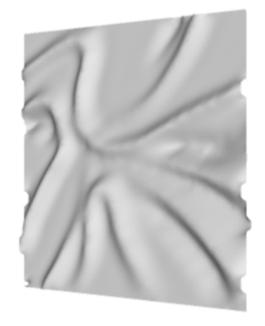
Processing Method
Improvement and innovation based on Shi’s method
Input models
Preprocessing
Sketching on the model
Current result
Shi’s result
Adding folds only
Fixed height only
★ Current work
Variable height
Variable height determined by input pen pressure
Improve constraint Taubin smoothing
Future work: Solve the problem of rugged folds
★ Future work
Adding and deleting folds
Solve the problem of rugged folds after smoothing
Notes:
In this step, Shi only allows the user to add folds only with a fixed height and the shape is not so good-looking.
In my current work, the user can make folds with variable height determined by input pen pressure with improved constraint Taubin smoothing.
In the future, I’d like to introduce the deleting folds method, and solve the problem of rugged folds after smoothing because of the reconstruction.

Slide 10
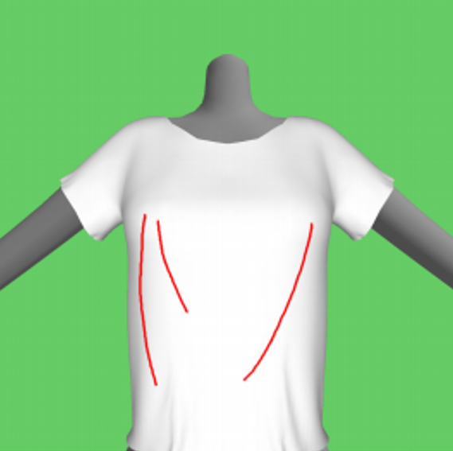
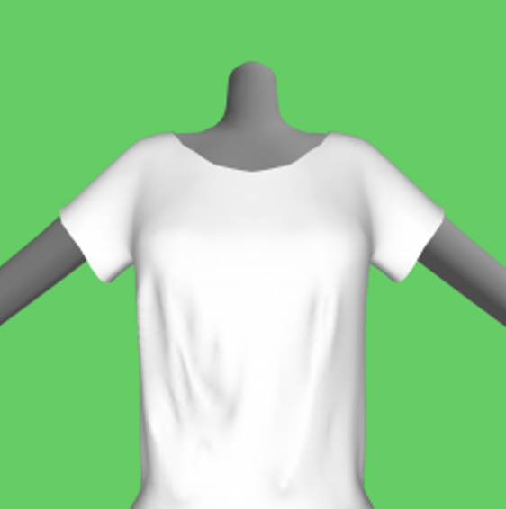
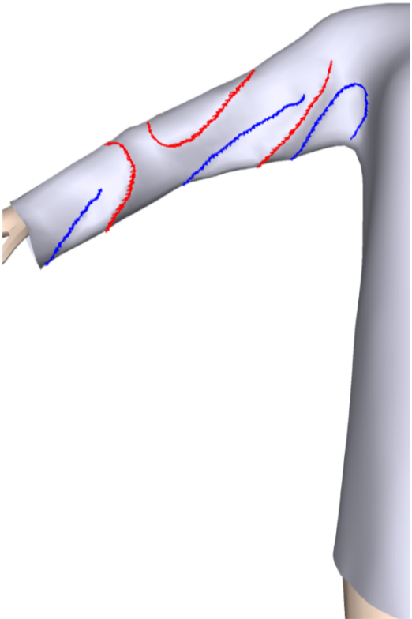
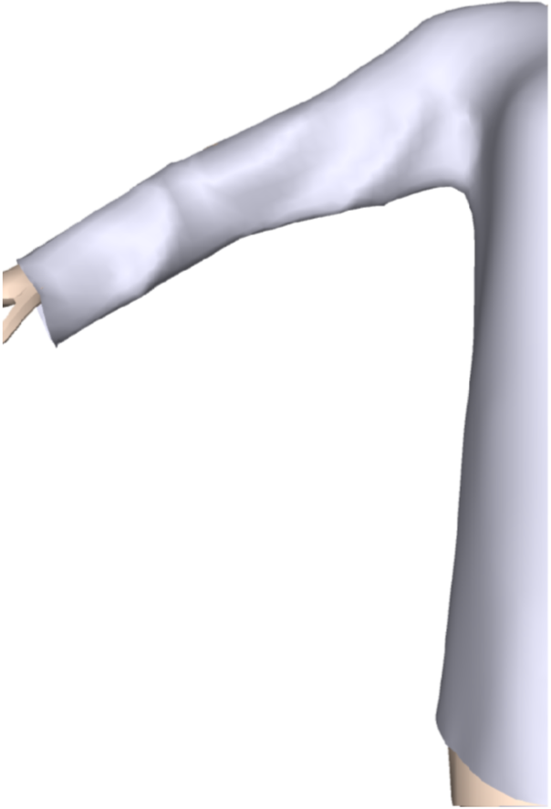
Processing Method
Improvement and innovation based on Shi’s method
Input models
Preprocessing
Sketching on the model
Shi’s input and output, the shapes of folds will change after modifying
Modifying and get the result
Results are different with expectation
★ Current work
Hold the shape after modification
★ Future work
Speed up modification processing, stabilize the shape and position of folds
Current input and output
Notes:
In this step, Shi‘s results after modifying are often different with expectation because the shape of folds will change after modifying.
So in my current work, I change the parameter of physical simulation and remeshing so that I can hold the shape after modification.
In the future, I’d like to speed up this step, stabilize the shape and position of folds.

Slide 11

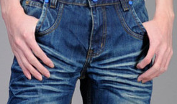
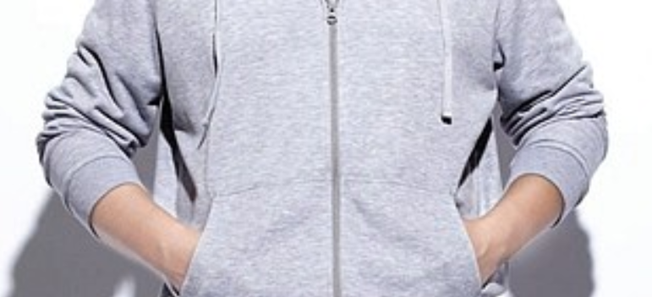
Conclusion and Future Work
The paper on my current work with Shi has been accepted in this year's Cyberworlds 2019 as full paper.
Goals: Make the realistic image of folds with “Y” shapes that the folds will overlap each other like jeans and sleeves with special reconstruction method, where is no good solution in the current approach.
https://art-science.org/cyberworlds-conference.org/index.html
Technical contribution: Proposed and improved a sketch-based method to generate a realistic cloth image with detailed fold and get better results than basic method.
Evaluation: Hope to make a numerical comparison with related real folds
Solve the mesh smoothing problem in surface reconstruction.
https://zh.wikipedia.org/wiki/%E7%89%9B%E4%BB%94%E8%A3%A4
Let the folds can stay the same shape and position after modification methods to fit the user’s expectation.
http://www.vancl.com/zixun/1474.html
Notes:
Currently, the paper on my current work with Shi has been accepted in this year's Cyberworlds 2019 as full paper.
The technical contribution I make is proposed and improved a sketch-based method to generate a realistic cloth image with detailed fold and get better results than basic method.
My goal is to make the folds with “Y” shapes that the folds will overlap each other like jeans and sleeves, where is no good solution in the current approach and I hope to make a numerical comparison with related real folds to be evaluation.
In the future, I’d like to solve the mesh smoothing problem in surface reconstruction, and let the folds can stay the same shape and position after modification methods.
This is the end of my presentation, thank you for your listening.

